Slide 1
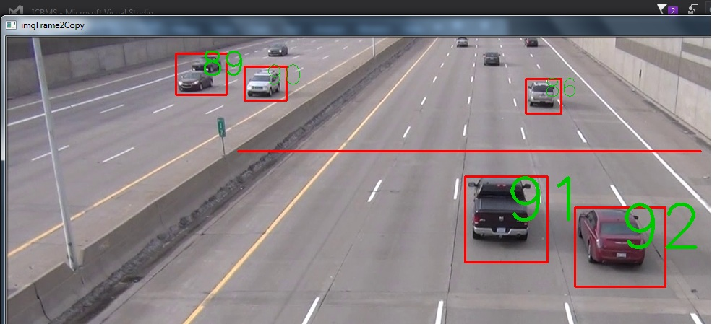
SELF DRIVING CARs PART II
This Photo by Unknown Author is licensed under CC BY-SA

Slide 2
ADVANCED LANE DETECTION

Slide 3
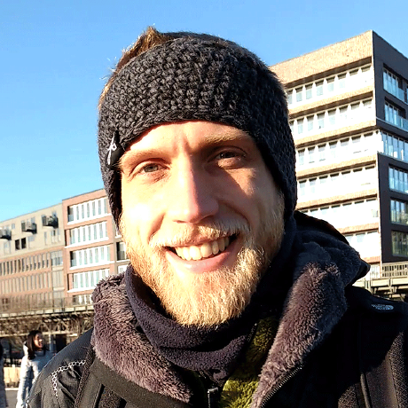
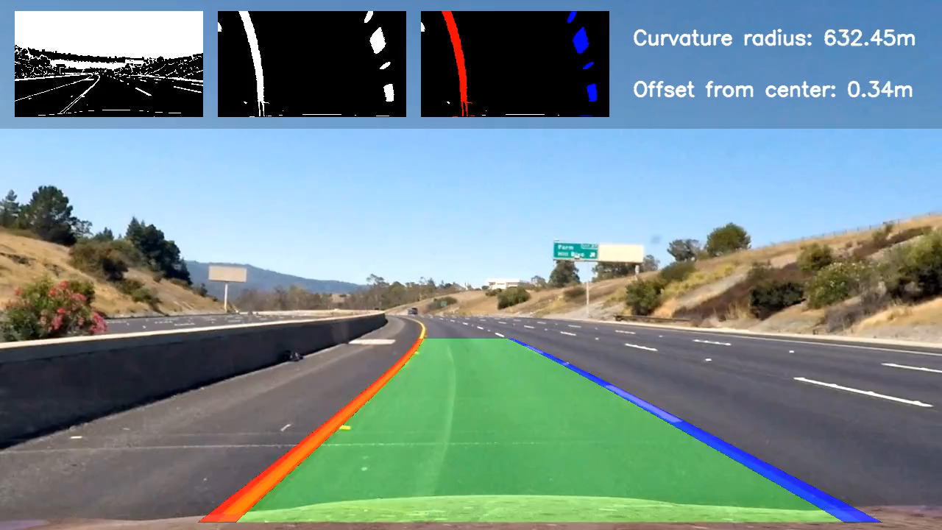
Acknowledgment:
The code for advanced lane detection is from Andrea Palazzi. We used this as the foundation to write our tests. The repository can be found at:
https://github.com/ndrplz/self-driving-car/tree/master/project_4_advanced_lane_finding
Robo-Geek is always grateful to the open source community. Our project is also being shared in reprocity.

Slide 4
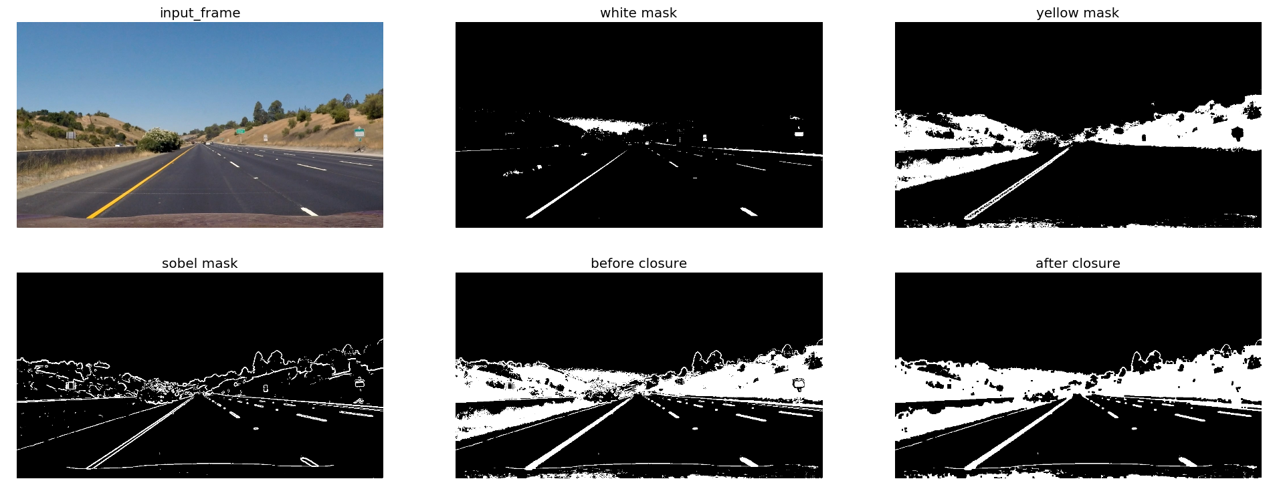
The pipeline
Compute the camera calibration matrix and distortion coefficients given a set of chessboard images.
Apply a distortion correction to raw images.
Use color transforms, gradients, etc., to create a threshold binary image.
Step 2
Step 3

